Slide 1
Task 2. choice of architecture in Data Warehousing Process
Arun Sen
Department of Information & Operations Mgmt.
Mays Business School
Texas A&M University

Slide 2
Task 2. Choice of Data Warehouse Architecture
1. What is Architecture?
It is a blueprint that dictates how the entire the project will look like and is very similar to an architectural blueprint for a house.
2. Types of DW Architecture
Enterprise-wide Data Warehouse
Data Marts (are of many types)
Vendor-supplied packaged data mart (one data mart in a box)
Vendor-supplied packaged data marts (multiple data marts)
Architected data mart (built in-house)
Multiple architected data marts (also built in-house)

Slide 3
Task 2. Choice of Data Warehouse Architecture
3. Types of Architecture
Enterprise-Wide Data Warehouse Architecture
E
T
L
Central Data Warehouse
Data Analysis
RDBMS
Dependent Data Mart
Data Analysis
Source Systems
Central Metadata

Slide 4
Task 2. Choice of Data Warehouse Architecture
3. Types of Architecture
Independent Data Mart Architecture
RDBMS
Sales Data Mart
E
T
L
Local Metadata
RDBMS
Financial Data Mart
Local Metadata
MDB
Human Resources Data Mart
Local Metadata

Slide 5
Task 2. Choice of Data Warehouse Architecture
3. Types of Architecture
Hub-and-spoke Data Mart Architecture
RDBMS
Data Analysis
E
T
L
RDBMS
Local Metadata
Data Analysis
Local Metadata
MDB
Data Analysis
Source Systems
Central Metadata
Local Metadata

Slide 6
Task 2. Choice of Data Warehouse Architecture
3. Types of Architecture
Enterprise Warehouse with Operational Data Store
Central Data Warehouse
Data Analysis
E
T
L
Data Mart
RDBMS
Data Analysis
Source Systems
Operational Data Store
It is a read/write data warehouse without any history or summary data sets
Central Metadata
OLTP Tools

Slide 7
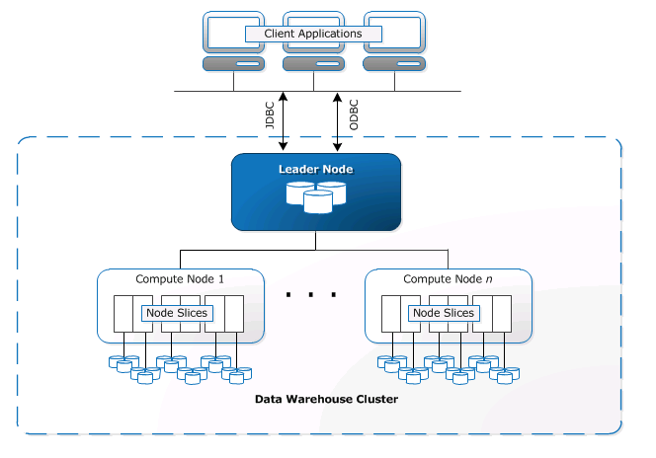
Task 2. Choice of Data Warehouse Architecture
3. Types of Architecture
Cloud-based Data Warehouse Architecture -- Amazon Redshift
https://linkedinlearning.tamu.edu/
Get to “Work with Redshift”
Click Watch full course
Explore the AWS data warehouse
Work with Redshift
Amazon Redshift is a relational database management system (RDBMS)
Amazon Redshift is based on PostgreSQL 8.0.2 and is somewhat different
The leader node manages communications with client programs and all communication with compute nodes.
Each compute node has its own dedicated CPU, memory, and attached disk storage, which are determined by the node type.
A compute node is partitioned into slices.
User data is stored on the compute nodes. Your SQL client communicates with the leader node, which in turn coordinates query execution with the compute nodes.
https://www.linkedin.com/learning/search?categoryIds=ALL&contentBy=ALL&continuingEducationUnits=ALL&difficultyLevel=ALL&durations=ALL&entityType=ALL&keywords=redshift%20&language=en_US&learningCategoryIds=ALL&purchaseModel=ALL&software=ALL&sortBy=RELEVANCE&sourceUrn=ALL&spellcheck=true&u=74650722
https://docs.aws.amazon.com/redshift/latest/dg/c_high_level_system_architecture.html

Slide 8
Task 2. Choice of Data Warehouse Architecture
Cloud-based Data Warehouse Architecture -- Others
3. Types of Architecture
Google BigQuery
https://www.linkedin.com/learning/google-cloud-platform-essential-training-for-administrators/bigquery?u=74650722 and then check BigQuery tab

Slide 9
Task 2. Choice of Data Warehouse Architecture
Cloud-based Data Warehouse Architecture -- Others
3. Types of Architecture
Panoply
https://panoply.io/data-warehouse-guide/data-warehouse-architecture-traditional-vs-cloud/
Purpose: It serves as a central repository where businesses can collect, store, and analyze structured and semi-structured data from multiple sources.
Deployment: 100% cloud-based, built on Amazon Redshift technology, but adds a management layer that automates many administrative tasks.
ETL/ELT: Panoply includes built-in data connectors for popular services (Salesforce, HubSpot, Google Analytics, etc.), so users can bring in data without building custom ETL pipelines.

Slide 10
Task 2. Choice of Data Warehouse Architecture
4. Focusing on Technical Architecture
We divide the entire technical architecture into two big pieces: back room and front room.
There are two major types of components in the technical architecture: services and data stores. Services are functions needed to accomplish the required tasks of the warehouse. For example, copying tables from one to another is a data transport service. Data stores are temporary or permanent landing places for data.
Key technical issues:
Metadata
Flexible service layers with the help of metadata catalog

Slide 11
Information Supply Chain
Back room Technical Architecture
Front room Technical Architecture
Data Source
Operational Data Store
Dependent Data Mart
analysis
Data Source
Enterprise-wide Data Warehouse
Dependent Data Mart
reporting
Dependent Data Mart
visualization
Staging Area Tables and files
Independent data marts
Data Source
Dependent Data Mart
Data mining
Data Source

Slide 12
Task 2. Choice of Data Warehouse Architecture
4.1. Back Room Technical Architecture
This is the place where data staging takes place.
Components
4.1.1. Data Stores
Source Systems
Data Staging Area
Presentation Servers
4.1.2. Data Staging Services
Extraction
Replication
Transformation
Data loading
Data staging job control
Backup and recovery
Archive and retrieval

Slide 13
Task 2. Choice of Data Warehouse Architecture
4.1.1. Source Systems (Data Store)
Most transaction systems are source systems. Examples are older legacy systems, IMS, ISMS, VSAM, flat files and DB2 systems.
Sometimes they are batch reports are sources also. Try to reverse-engineer these.
Data Models used in this stage are hierarchical, fully denormalized flat files, third normal forms etc.

Slide 14
Task 2. Choice of Data Warehouse Architecture
4.1.1. Source Systems (Data Store)
Other examples of source systems are:
Client-server based ERP systems (ERP cannot support decision support)
Reporting Instance (another copy of operational data for reporting purposes only)
Operational data store (ODS) (it is a subject-oriented, integrated, frequently updated store of detailed data to support transaction systems with integrated data.)

Slide 15
Task 2. Choice of Data Warehouse Architecture
4.1.1. Data Staging Area (Data Store)
It is a construction site for the warehouse.
Investment in data staging, that services a broad range of transformation requirements, will avoid requiring each business process to invest understanding of the sources.
create dimensions at this stage in flat files
keep things available for emergency recovery operations
Storage Types
flat files -- probably fastest
relations -- not very efficient, slow; but tools are available to work with relations.
Data Models -- mostly 3NFs

Slide 16
Task 2. Choice of Data Warehouse Architecture
4.1.2. Data Staging Services
Overall requirements for data staging services -
Productivity support.
code library check in/check out
version control
development tools
Usability
the data staging system must be usable. Should have GUI, documentation tools
Metadata driven
SQL code and Cobol code must be driven by the metadata

Slide 17
Task 2. Choice of Data Warehouse Architecture
Service 1: Extraction Services
60% of the DW development hours are spent on the extract process.
Most often, the challenge is determining what data to extract and what kinds of filters to apply.
Most extract processes generate temporary load files that become the input data to the next activity downstream.
Most extracts are based on the host platform and are designed to get the data out of the source and into a simplified and easily accessible form.
Data needs to be pulled from the multiple systems built with multiple data stores hosted on multiple platforms ...

Slide 18
Task 2. Choice of Data Warehouse Architecture
Service 1: Extraction Services
Generating codes to extract files.
Types of extracts:
incremental loads (only the records that have changed or have been added since the previous load)
transaction events (we may want all kinds of events like insertion, deletion and modification)
full refresh (sometimes it is better to pull the full table rather than worry about figuring out what has changed)

Slide 19
Task 2. Choice of Data Warehouse Architecture
Service 2: Replication Services
It may mean to continuously update a table in the staging database during the day, so it is up-to-date and available to support the data staging process at night

Slide 20
Task 2. Choice of Data Warehouse Architecture
Service 3: Transformation Services
Once the data is extracted from the source system, a range of unnatural acts is performed on it to convert it into something presentable to the users and valuable to the business.
Following is a tentative list of transformation that may need to be included in the warehouse.
integration (involves generating surrogate keys, mapping keys from one system to another, etc.)
slowly changing dimension maintenance
referential integrity checking

Slide 21
Task 2. Choice of Data Warehouse Architecture
Service 3: Transformation Services
denormalization
renormalization (source may come as a denormalized flat file and we need to normalize parts of it)
cleansing
merge/purge
data type conversion
calculation, derivation and allocation
aggregation
etc.

Slide 22
Task 2. Choice of Data Warehouse Architecture
Service 3: Data Loading Services
The capability that you need during the data loading process are a function of target platform.
Support for multiple targets (atomic data marts may be on one DBMS and the business process data marts may be on another. Each may have its own syntax.)
Load optimization (Most DBMS has bulk loading capabilities that can be scripted and invoked by the data staging tool through an API.)
Load process support

Slide 23
Task 2. Choice of Data Warehouse Architecture
ETL Tools
First Generation ETL Tools
used mostly Cobol as source code since data was originally stored in the main frame
generated mostly Cobol
performance was very good
Limitations
needed an in-depth knowledge of programming on the different platforms
maintenance is difficult because the code was disseminated to different platforms and differed with the type of sources and target.

Slide 24
Task 2. Choice of Data Warehouse Architecture
ETL Tools
Second Generation ETL Tools
generation and compilation of source code
use of intermediate files to pass data from the extraction to the transformation process, and from transformation process to the load process.
use of single-threaded engines
lack of support for parallelism
Advantages
tools are mature as they are out there for 20 years
tools are good for extracting data from the legacy systems
Limitations
high cost
use of intermediate files limits the throughput
significant number of metadata must be generated manually
Examples:
PASSPORT from Carleton Corporation
Prism from Ardent Software
SAS/Warehouse Administrator from SAS Institute, Inc

Slide 25
Task 2. Choice of Data Warehouse Architecture
ETL Tools
Third Generation ETL Tools
extract program is generated automatically as executable code
extraction/transformation/load process runs on a server platform
functions supported include monitoring, scheduling, extraction, scrubbing, transformation, bulk load, etc.
higher throughput because data are not written to intermediate files
higher percentage of metadata is generated automatically.

Slide 26
Task 2. Choice of Data Warehouse Architecture
ETL Tools
Advantages
lower cost suites
products are easy to learn and need very little training
ETL functions are highly integrated, etc.
Limitations
some 2nd generation ETL tools are limited to RDBMS source databases
not mature
Examples:
PowerMart from Informatica
Ardent 3.5 DataStage from Ardent Software Inc
Sagent Data Mart Solution from Sagent Technology

Slide 27
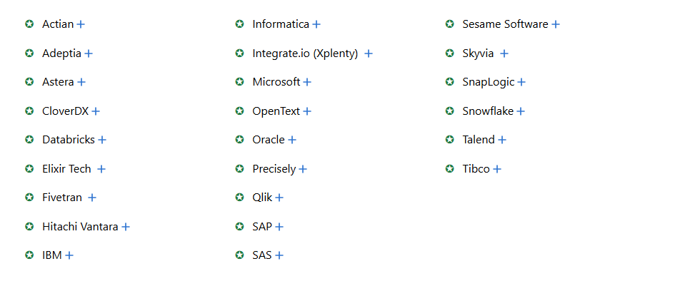
Task 2. Choice of Data Warehouse Architecture
Current Well-known ETL Tools (2025)
https://www.passionned.com/products/etl-data-integration-guide/

Slide 28
Task 2. Choice of Data Warehouse Architecture
start
5. Presentation Server (Data Warehouse/Data Mart)
These are the target platforms where the data is stored for direct querying by end users, reporting systems and other end-user tools.
Two kinds of Presentation Servers:
Enterprise-wide Data Warehouse (Inmon)
Data warehouse is a collection of data marts that sit on a bus (Kimball)
There are two kinds of data marts:
Atomic data marts
it holds data at the lowest-common-denominator level i.e., lowest level of detail necessary to meet most of the high-value business requirements.
Atomic data marts should be relational due to the details in the data.
Atomic data marts should be built around dimensional model with details.

Slide 29
Task 2. Choice of Data Warehouse Architecture
5. Presentation Server (Data Warehouse/Data Mart)
Aggregated business process data marts
The data related to each core business process is called a business process data mart.
For example, Marketing might like to analyze the data to get a sense for promotional effectiveness.
Business process data marts should be either relational or proprietary Multidimensional OLAP databases.
Business process data marts should be built around same dimensional structure of the data in the atomic data mart.

Slide 30
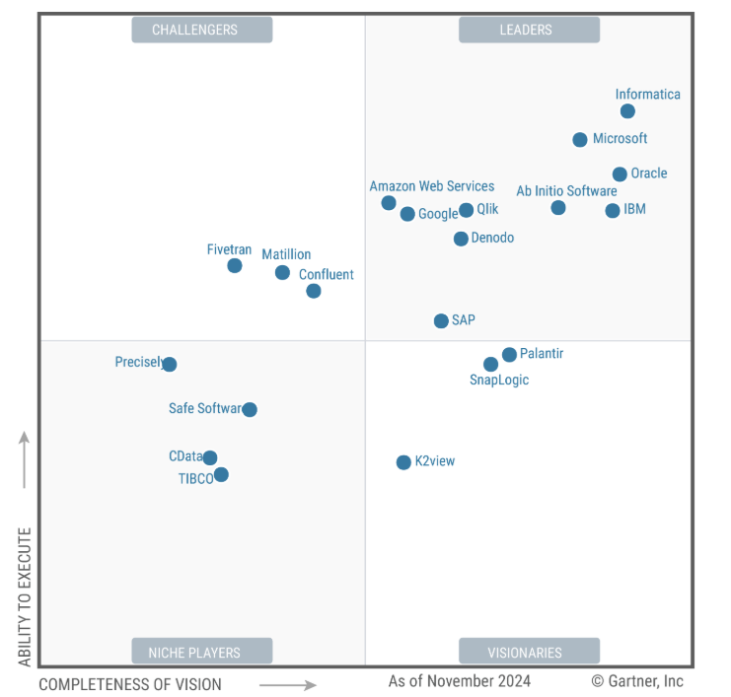
Task 2. Choice of Data Warehouse Architecture
5. Presentation Server (Data Warehouse/Data Mart)
https://www.informatica.com/data-integration-magic-quadrant.html?formid=26118&programName=24Q4-DPDS-NAM-CLO-NP-NI-NV-GartnerQuadrantDatIntgrtn-0-PT5088-G&utm_source=google&utm_medium=paid_search&utm_campaign=24Q4-DPDS-NAM-CLO-NP-NI-NV-GartnerQuadrantDatIntgrtn-0-PT5088-G&utm_country=us&utm_creative=Cloud-IT_Data-Integration_NB_Exact_Google_Search_NAM_US_Leads_CPA_English&utm_journey=clo&utm_cost=cpc&utm_term=gartner%20magic%20quadrant%20for%20data%20integration%20tools&gad_source=1&gad_campaignid=21156044056&gbraid=0AAAAADnfLNN_ndzqtSs-7tzrQo0zz6VHH&gclid=CjwKCAjwisnGBhAXEiwA0zEOR3umsutTbrJZHYbyGLWc1j76ojo_O6nBYjsCs7UtLZ9iY8m4aKFMYBoC1zAQAvD_BwE

Slide 31
Task 2. Choice of Data Warehouse Architecture
Selection of Target DBMS for DW/DM
Choice 1: Conventional RDBMSs in combination with ROLAP tools
Strengths:
No size limit on target database (scalable to terabytes)
No need for proprietary databases and tools
RDBMSs have been enhanced to support the specialized requirements for DW. Techniques include parallel query execution, parallel data management, bit-mapped indexes, SQL extensions for OLAP, etc.
Ad hoc queries can be directed to any data in the DW
Detailed data and aggregated data can be stored in the same database
DBMS Engine
ROLAP Engine

Slide 32
Task 2. Choice of Data Warehouse Architecture
Selection of Target DBMS for DW/DM
Choice 1: Conventional RDBMSs in combination with ROLAP tools
Strengths:
High-speed query processing using symmetric multiprocessors (SMP), massively parallel processors (MPP), and clustered multiprocessors (NUMA).
Availability of front-end ROLAP tools from multiple vendors
ROLAP tools support multi-dimensional analysis of relational data
Supports open systems standards such as OLE DB, ODBC, SQL
Portable

Slide 33
Task 2. Choice of Data Warehouse Architecture
Selection of Target DBMS for DW/DM
Choice 1: Conventional RDBMSs in combination with ROLAP tools
Limitations
Originally designed for OLTP
Slower than MDB
SQL is not designed for calculations and OLAP functions
Sophisticated techniques are required to generate SQL
Examples
Oracle, IBM DB2, Teradata, SQL Server (Microsoft), Redbrick DW (Informix Software), CA-OpenIngres (from Computer Associates), Sybase Adaptive Server Enterprise etc.

Slide 34
Task 2. Choice of Data Warehouse Architecture
Selection of Target DBMS for DW/DM
Choice 2: Multidimensional DBMS
A multidimensional DB is a data structure with three or more independent dimensions. MDDBs do not use relational tables, but store data in multidimensional arrays. A spreadsheet is a 2-dim array. MDDBs are similar to spreadsheet, but they store data in three or more dimensions
.
MDB/MDDB arrays are recommended for relatively small data marts ( < 50 GB) where performance is critical
DBMS Engine
MDDB Engine

Slide 35
Task 2. Choice of Data Warehouse Architecture
Selection of Target DBMS for DW/DM
Choice 2: Multidimensional DBMS
Components of a MDB include
Relational DBMS to store detailed data
MDDB server to store aggregate data (contains base data, pre-calculated results stored in MD array and an indexing structure required to store the data)
Metadata (local data definitions and semantics in business terms)

Slide 36
Task 2. Choice of Data Warehouse Architecture
Selection of Target DBMS for DW/DM
Choice 2: Multidimensional DBMS
Multidimensional viewer
Types of data stored in a multidimensional array
base data - historical data that have not been aggregated into arrays
pre-computed aggregates or summaries
derived or calculated data
indexes used to locate blocks of data in the array
It typically takes 8-10 hours to pre-compute aggregated data, derived data and indexes for a larger multidimensional array

Slide 37
Task 2. Choice of Data Warehouse Architecture
Selection of Target DBMS for DW/DM
Choice 2: Multidimensional DBMS
Strengths
High performance (sub-second response to queries and OLAP analysis), sophisticated multidimensional calculations
Optimized for OLAP and not constrained by limitations of SQL
Support for several complex DSS queries (e.g., trend analysis, drill down, etc.)
Advanced indexing options (B-Trees and bitmaps)
No complex RDBMS functions

Slide 38
Task 2. Choice of Data Warehouse Architecture
Selection of Target DBMS for DW/DM
Choice 2: Multidimensional DBMS
Limitations
Requires yet another proprietary DB solution
Max size of 3 GB of raw data, which may expand by a factor of 10 to 100 for calculated data. Size limit is due to time to pre-compute.
Most MDBs cannot load data incrementally
Static, pre-computed dimensions and calculations. Lack of support for dynamic changes in dimension structure
Lack of standard multidimensional model or access method

Slide 39
Task 2. Choice of Data Warehouse Architecture
Selection of Target DBMS for DW/DM
Choice 2: Multidimensional DBMS
Examples
SAS Multidimensional Database Server
Focus/Fusion from Information Builders, etc.
Essbase from Hyperion Solutions Corp.

Slide 40
Task 2. Choice of Data Warehouse Architecture
Selection of Target DBMS for DW/DM
Choice 3: Hybrid OLAP (HOLAP)
Combination of RDBMS and MDB (best of both worlds), controlled by OLAP server
RDBMS used for detailed data stored in large databases
MDB used for fast, read/write OLAP analysis and calculations
OLAP server routes queries to either RDBMS or MDB
Result set form RDBMS may be processed on-the-fly in server
Examples
Microsoft SQL Server OLAP Services
IBM DB2 OLAP Server

Slide 41
Task 2. Choice of Data Warehouse Architecture
Selection of Target DBMS for DW/DM
Recommendations
Use RDBMS and ROLAP tools to provide multidimensional views of large relational target databases
Use RDBS features, such as parallelization, and bit-mapped indexes, to provide acceptable performance
Use MDB for high-performance analysis of moderate size databases. MDBs are often used for data marts.
Use hybrid approach for applications that require access to detail data and fast OLAP computations.

Slide 42
Task 2. Choice of Data Warehouse Architecture
4.2. Front Room Technical Architecture
This is the public face of the warehouse
Data Access Service is needed to help people get the information they need from the warehouse
Components
Types
Access Tool Data Stores (temporary storage)
Standard Reporting Data Stores
Personal Data Marts
Disposable Data Marts
Application Models

Slide 43
Task 2. Choice of Data Warehouse Architecture
4.2. Focusing on Front Room Technical Architecture
Services
Remember that there are different user types
Warehouse browsing
Activity monitoring
Query management
Standard reporting
Data access tool capabilities (include OLAP tools, data mining, data visualization, and other data access tools)
Web implications of data access

